Slide 1



Ad_Hoc Insights
Consumer Goods
CREATED BY
VISHAL BANKAR

Slide 2

1. Objective
Agenda
2
Company Details & Market
3. Data , Requests & Tools

Slide 3

Objectives
Atliq Hardware (fictitious corporation) is one of the major computer hardware manufacturers in India, with a strong presence in other nations.
Nevertheless, the management did note that they do not have sufficient insights to make prompt, wise, and data-informed judgments.
Plan to expand the data analytics team by adding junior data analysts.
The company seeks insights for10 ad hoc requests.

Slide 4

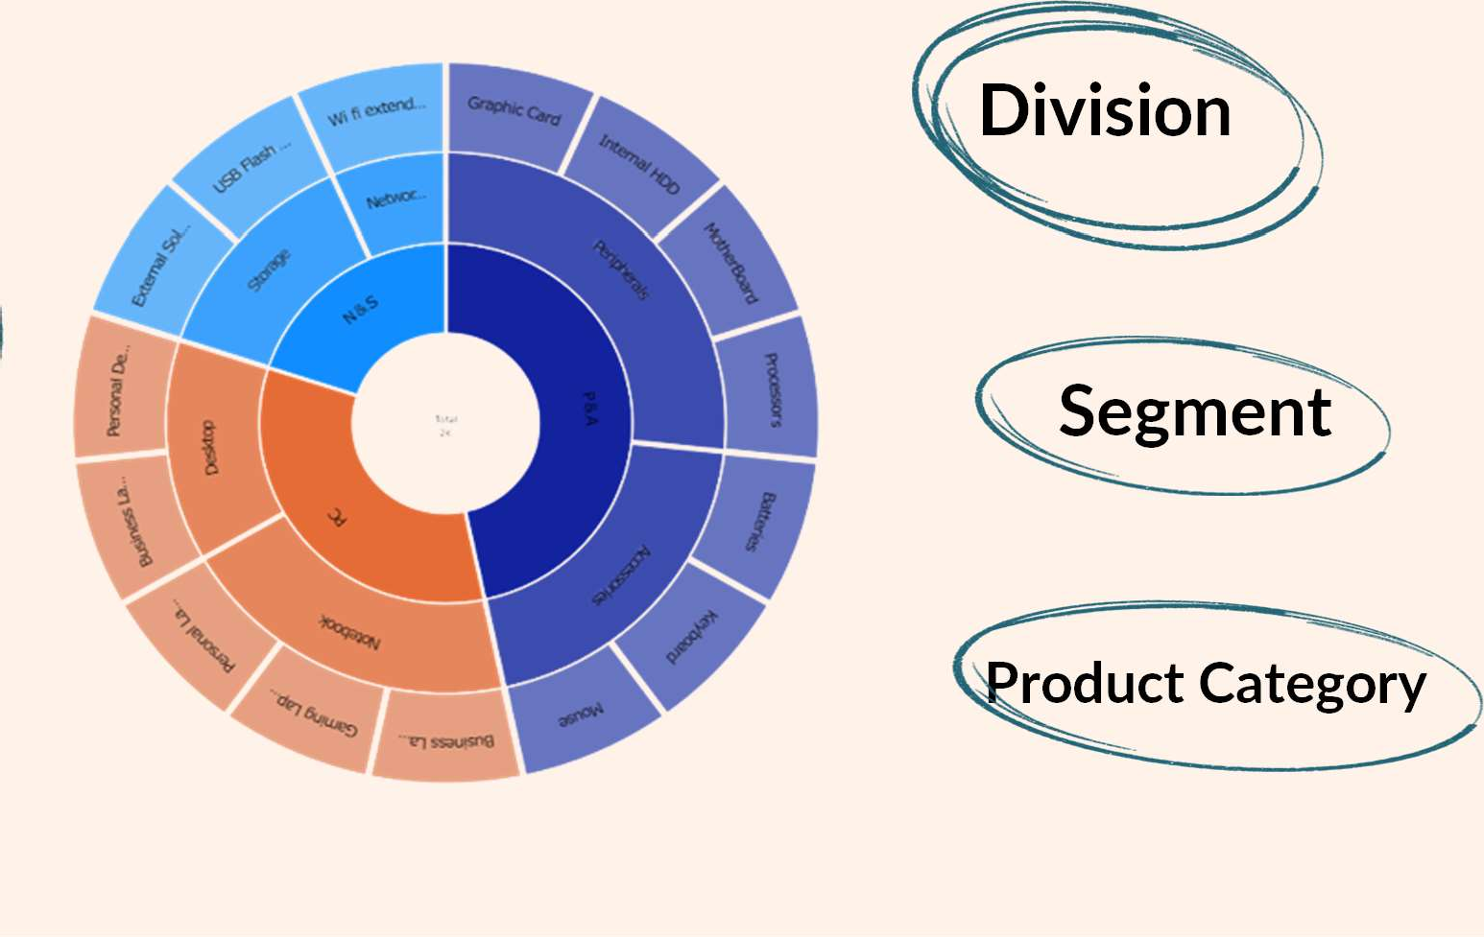
Company Details
Atliq Hardware is a computer hardware and accessory manufacturer
Division
FISCAL YEAR
SEPTEMBER - AUGUST
Segment
Product Category

Slide 5

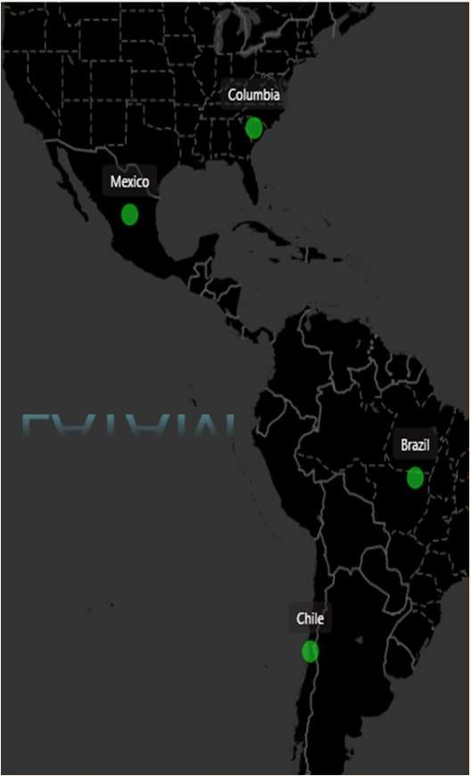
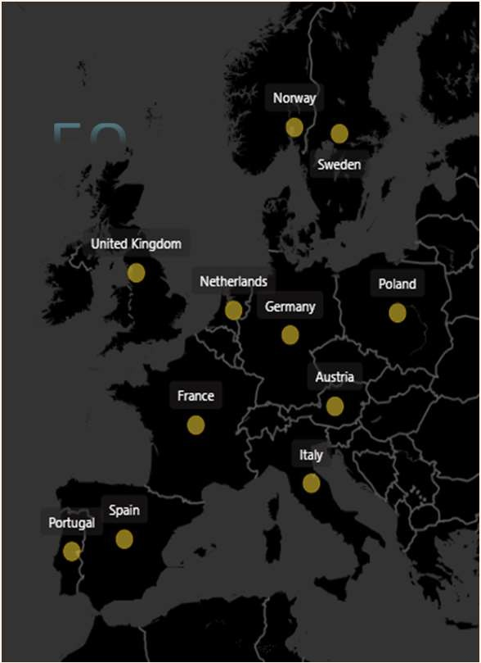


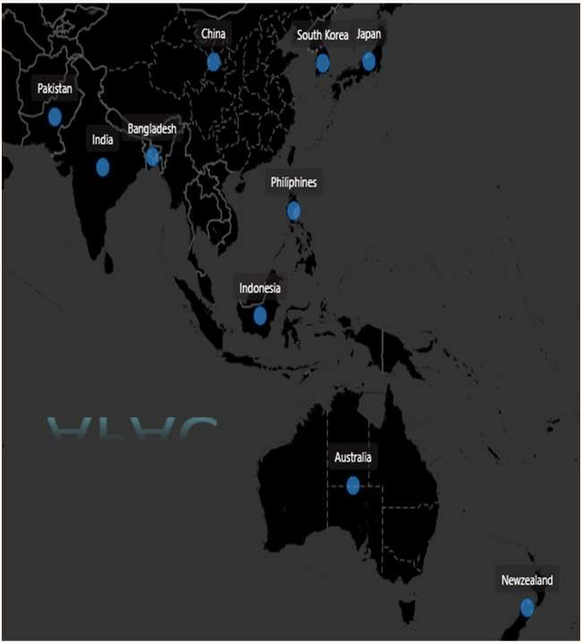








Atliq Hardware’s Market

Slide 6

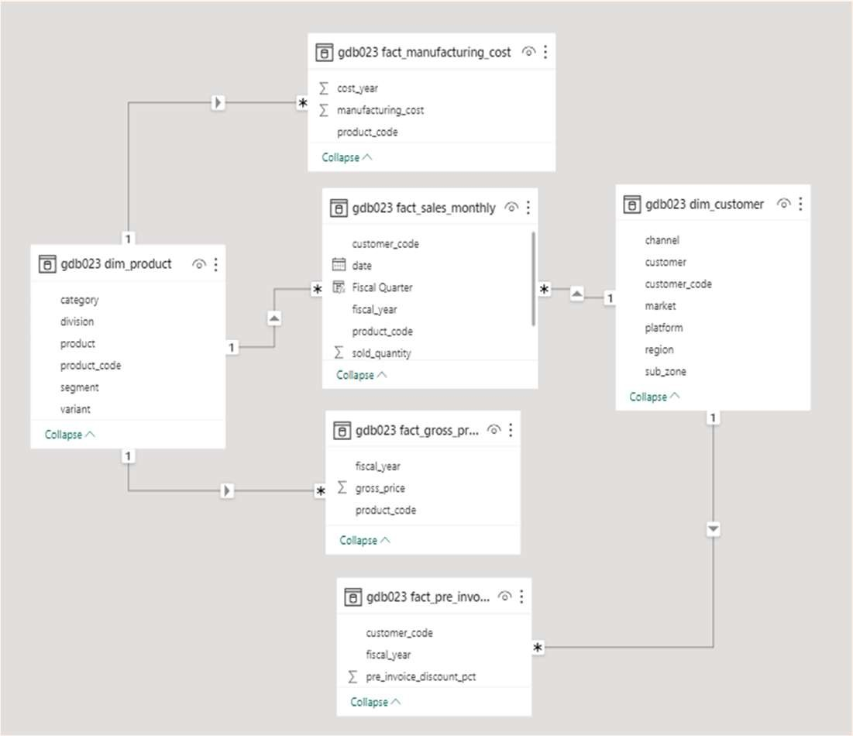
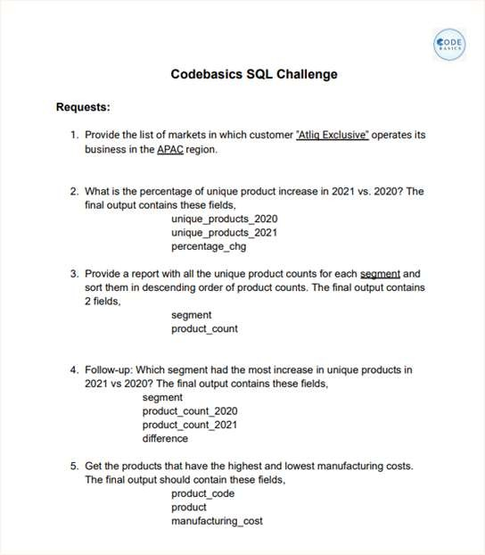
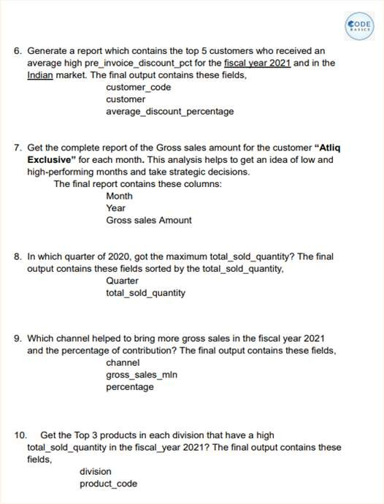

Data , Request & Tools
For Analysis & Visualisation

Slide 7
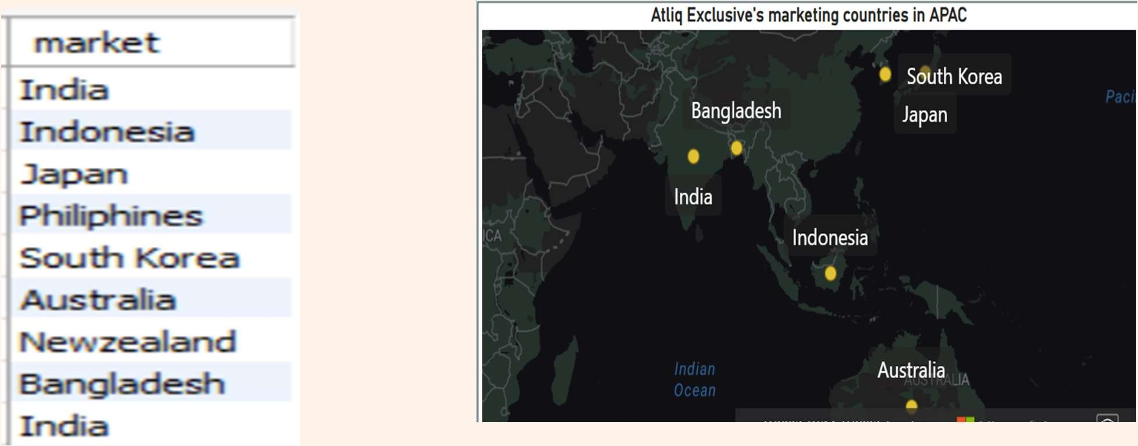
1 . Provide the list of markets in which customer "Atliq Exclusive" operates its business in the APAC region.

Slide 8
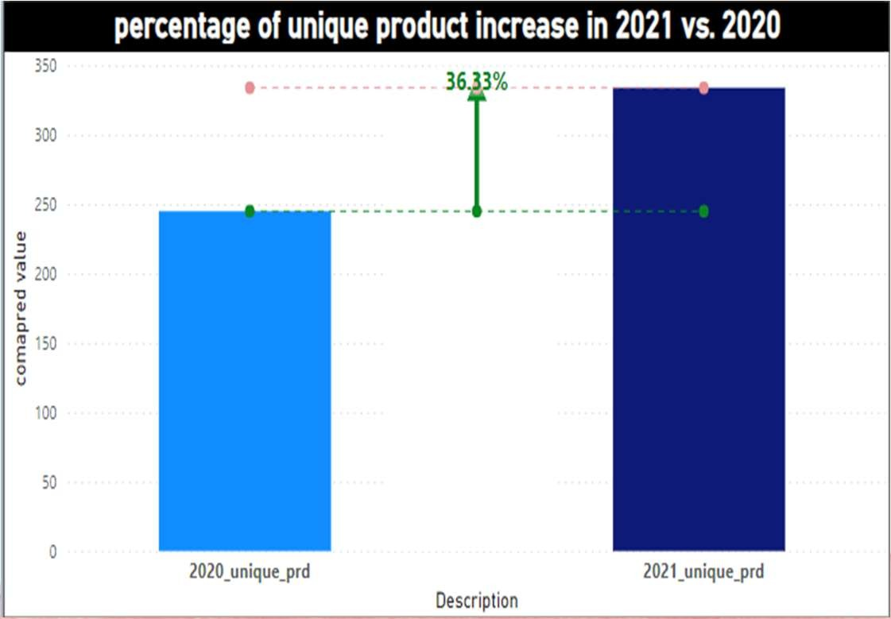
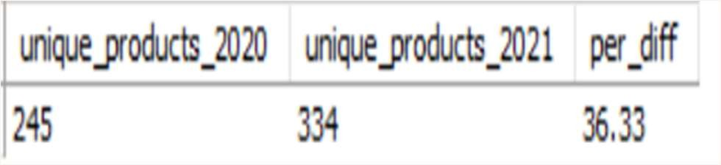

2 . What is the percentage of unique product increase in 2021 vs. 2020? The final output contains these fields, unique_products_2020 unique_products_2021 percentage_chg
36.33 %
Insight :
Demand & Production of new products increased

Slide 9
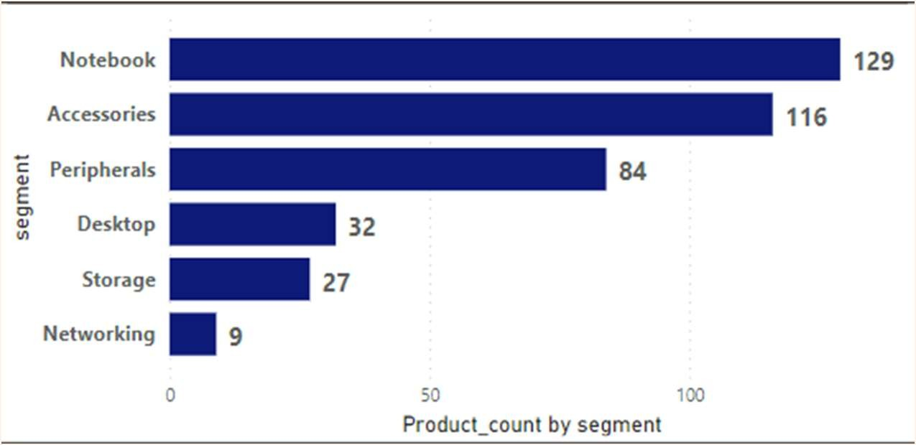
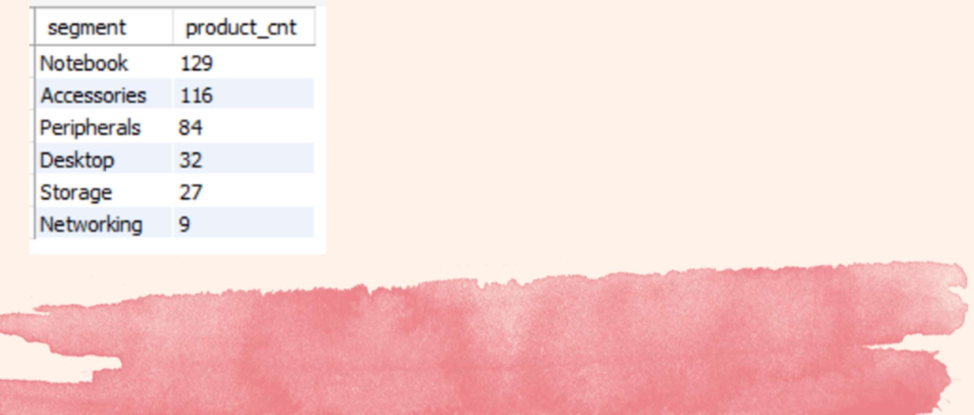
3. Provide a report with all the unique product counts for each segment and sort them in descending order of product counts. The final output contains 2 fields,
segment product_count
Insights:
Segments: notebooks, accessories, and peripherals are showing significant manufacturing growth as compared to desktops, storage, and networking.
Notebooks, accessories, and peripherals constitute 83% of the total manufactured product.

Slide 10

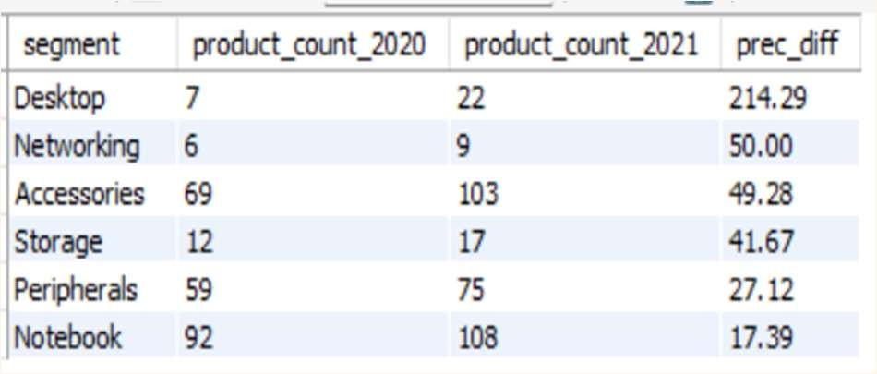
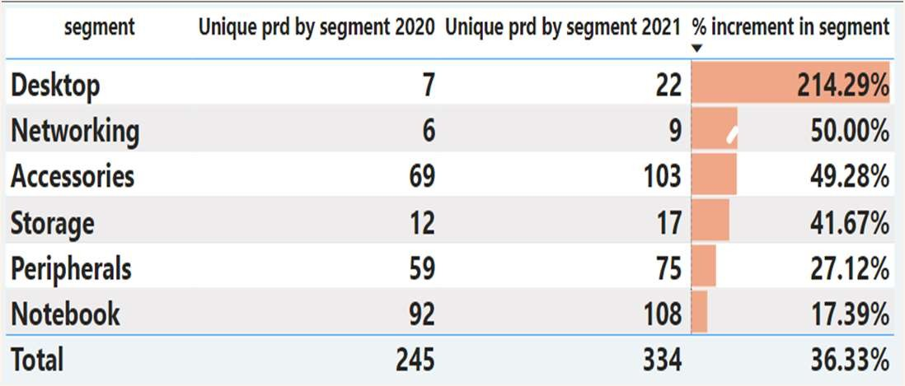
4 . Follow-up: Which segment had the most increase in unique products in 2021 vs 2020? The final output contains these fields, segment
product_count_2020 product_count_2021 difference
Insights:
Desktop had the largest increase in production.
Peripherals and Notebook are experiencing slower production growth than other segments.

Slide 11
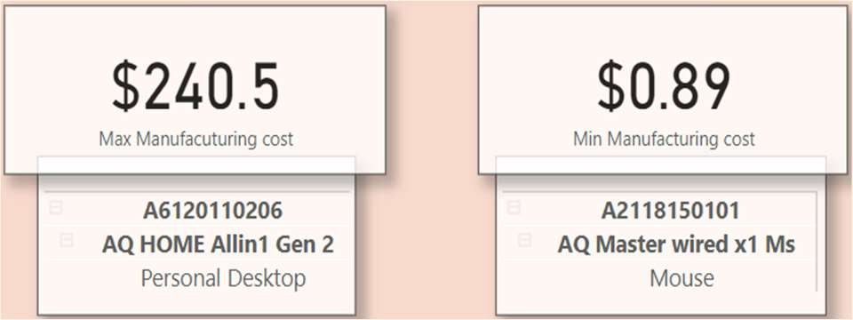
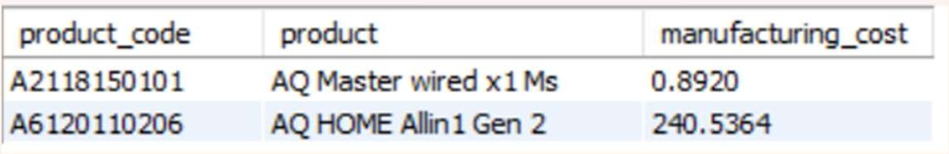
5 . Get the products that have the highest and lowest manufacturing costs.The final output should contain these fields, ---> product_code product manufacturing_cost
Product with highest and lowest manufacturing costs
Insights:
Mouse: AQ Master wired x1 Ms (Variant:Standard1) has the lowest manufacturing cost.
Personal Desktop: AQ Home Allin1 Gen2 (Variant:Plus3) has the highest manufacturing cost.

Slide 12
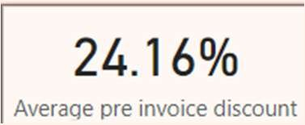
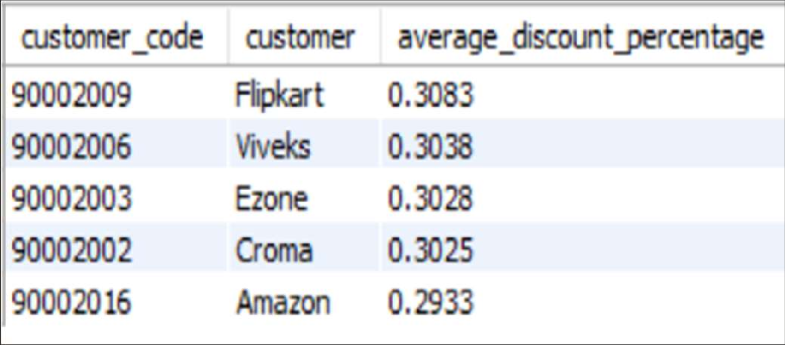
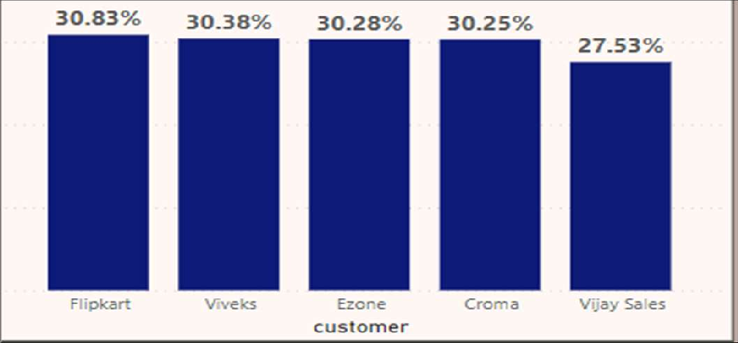
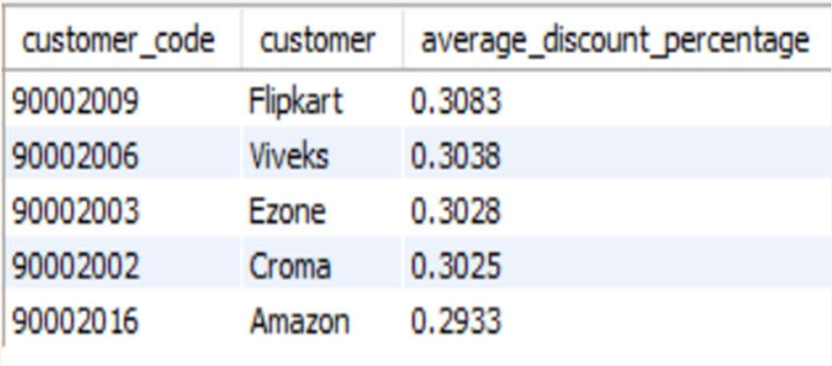
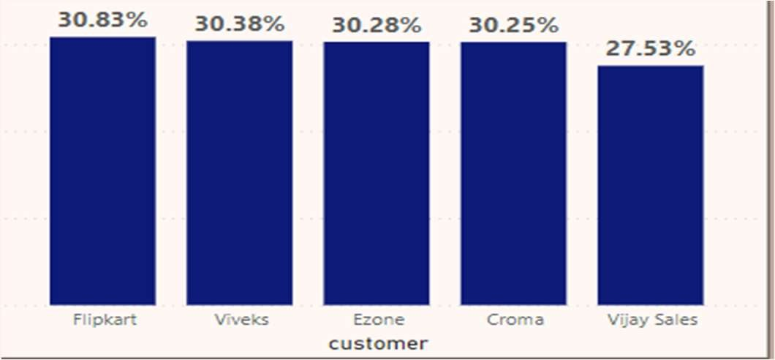
6 . Generate a report which contains the top 5 customers who received an average high pre_invoice_discount_pct for the fiscal year 2021 and in the Indian market. The final output contains these fields,
customer_code customer average_discount_percentage
Top 5 customers with High average discount percentage
Insights:
The largest average pre-invoice discount was given to Flipkart.
The least average pre-invoice discount was given to Amazon.

Slide 13
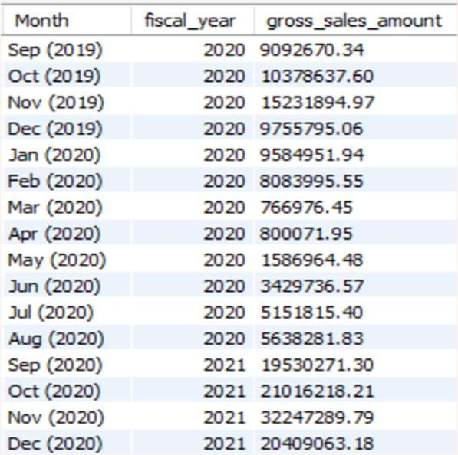

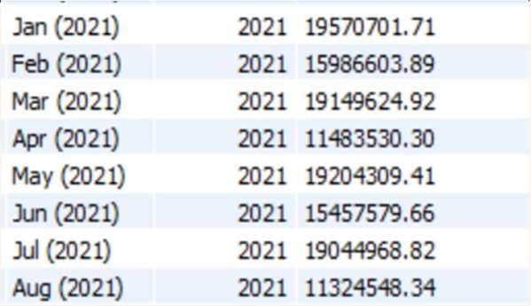
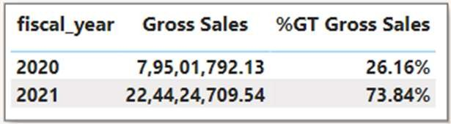
7 . Get the complete report of the Gross sales amount for the customer “Atliq Exclusive” for each month. This analysis helps to get an idea of low and high-performing months and take strategic decisions.The final report contains these columns: Month Year Gross sales Amount
Gross Sales for Atliq Exclusive
FY 2020
Insights:
The lowest Gross sales total for both fiscal years is in March(2020).
The highest Gross sales total for both fiscal years is in November (2020).
73.8% of the total Gross sales figure is in FY2021
FY 2021

Slide 14
FY 2021
FY 2020
Highest Gross sales
Lowest Gross sales

Slide 15
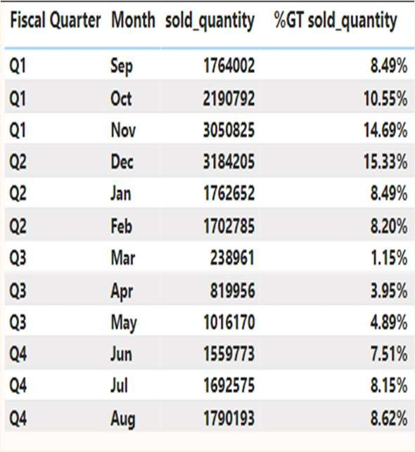
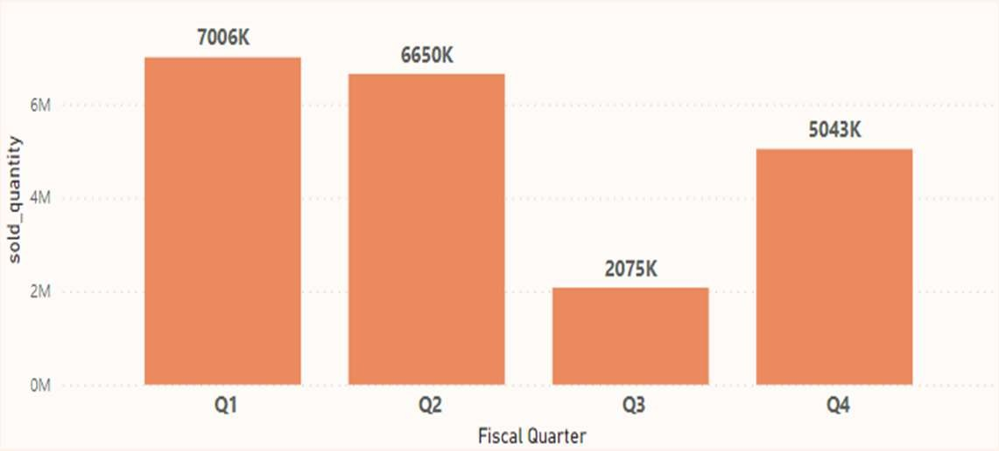
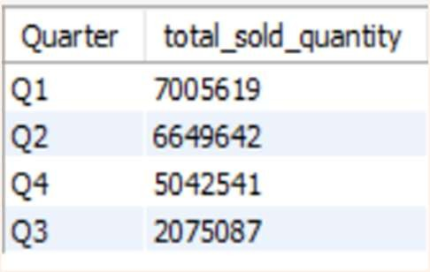

8 . In which quarter of 2020, got the maximum total_sold_quantity? The final output contains these fields sorted by the total_sold_quantity, Quarter ,total_sold_quantity
Quarter wise sold quantity for FY 2020
Insights:
Quarter 1 of FY2020 has seen the most units sold overall, while Quarter3 had the fewest.
The highest and lowest overall sold quantity is in December and March.
Quarter1 accounts for approximately 34% of the total sold quantity for FY-2020.

Slide 16
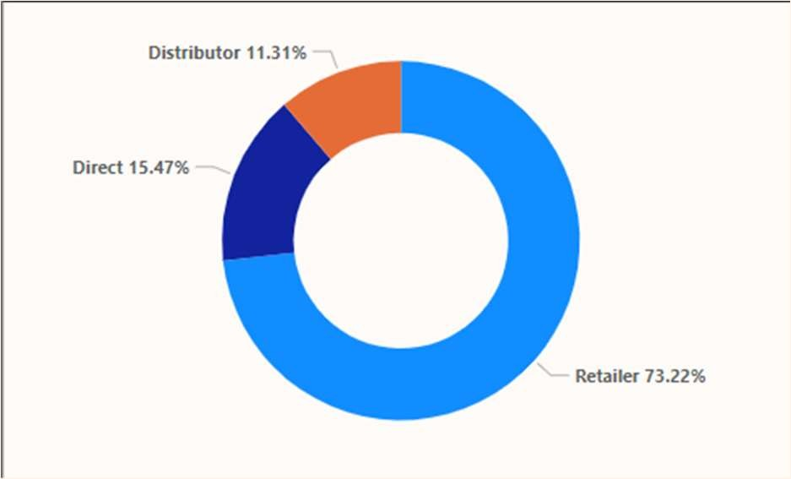
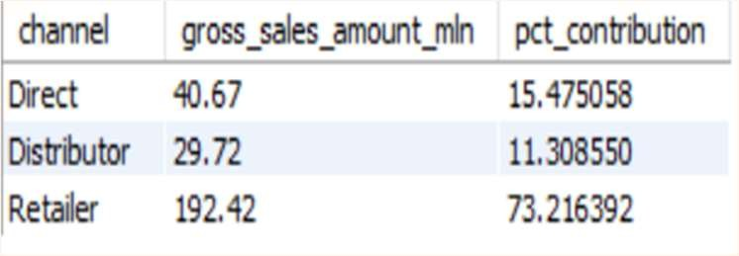
9 . Which channel helped to bring more gross sales in the fiscal year 2021 and the percentage of contribution? The final output contains these fields, channel gross_sales_mln percentage
Gross Sales by channel in FY 2021
Insights:
Channel: "Retailer " helped bring maximum sales to the company with 73.22% as the contribution percentage.
Channel: "Distributor " makes the least contribution at a percentage of 11.31%

Slide 17
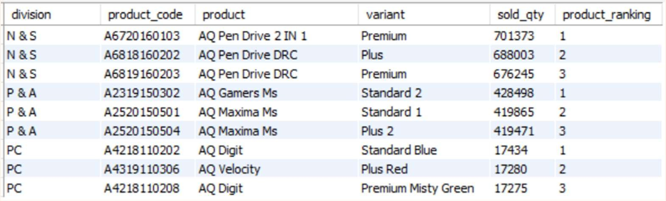

10 . Get the Top 3 products in each division that have a high total_sold_quantity in the fiscal_year 2021? The final output contains these fields,--> division product_code product total_sold_quantity rank_order
Insight:
Every division has a product with different variants that appears twice in the top three products by division list.

Slide 18

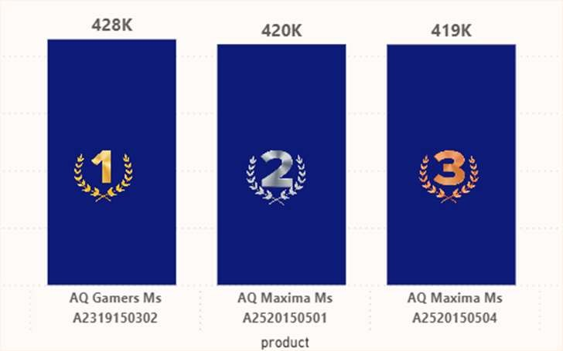
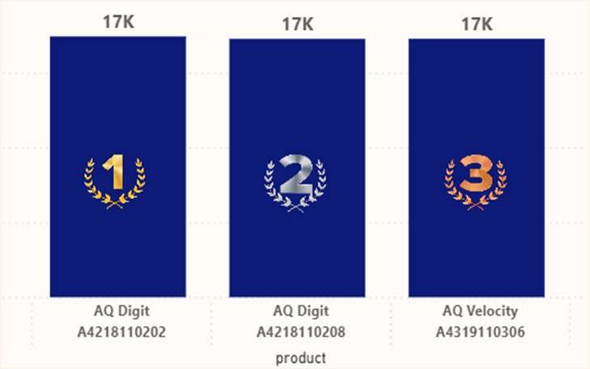
Top 3 products by N & S division
Top 3 products by P & A division
Top 3 products by PC division

Slide 19
THANK YOU !

